Slide 1
Geophysics at mine sites:
Mapping near mine geology with advanced geophysical technology.
Applications for delineation, mine planning and exploration.
Presented by Rob Gordon MBA P. Eng.
CIM 2017, Montreal
World Leaders in Ground Geophysics
Since 1986
Notes:
Quantec supplies Geophysical surveys and services. Since 1986.
In 2000 we launched the first commercialised DCIP MT system called TITAN to provide deep Earth Imaging

Slide 2
Presentation Objectives
Demonstrate new role of effective imaging at mines
Overview issues and solutions regarding effective use of geophysical imaging near mine and on mine site environments
  Present examples of deep imaging mine site surveys and results
Notes:
that ultimately demonstrate that mine site imaging can provide various forms of reduced risk in exploration and the gaining of critical knowledge for planning
these surveys highlight critical knowledge gaps, of then current understandings on the presented cases, with respect to;
resource size and geometry,
new discoveries
mine planning activities

Slide 3
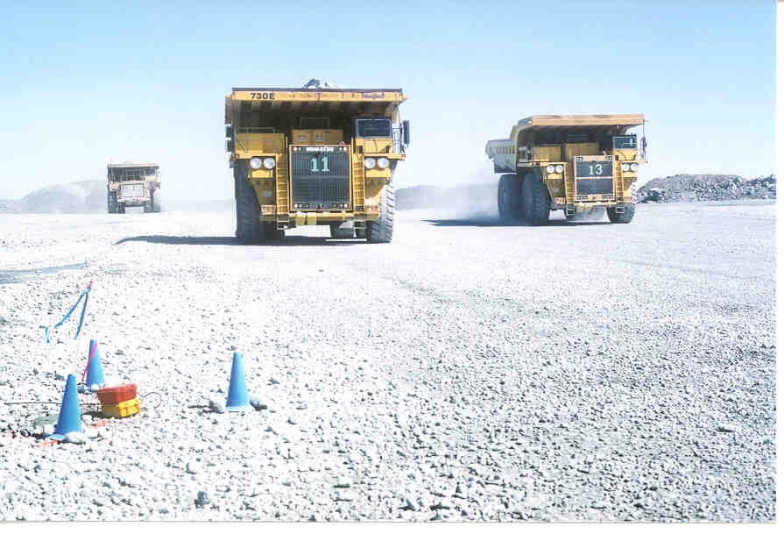
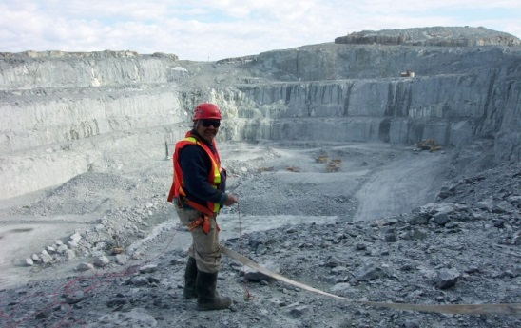
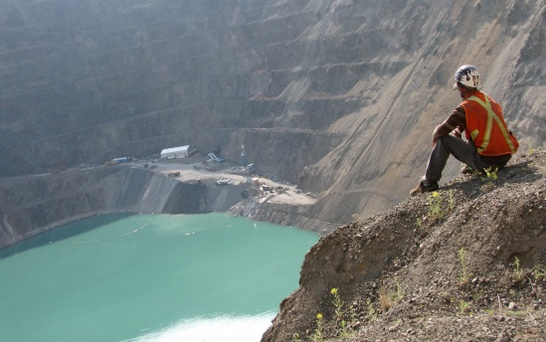
Geophysics at mine sites ?
Notes:
Probably the most successful geophysics at mine sites has been borehole EM work over the years. The shallow penetration of most traditional geophysics and the cultural noise that impacts those surveys has prevented geophysics , in the most part, from being a useful tool near the mines.

Slide 4
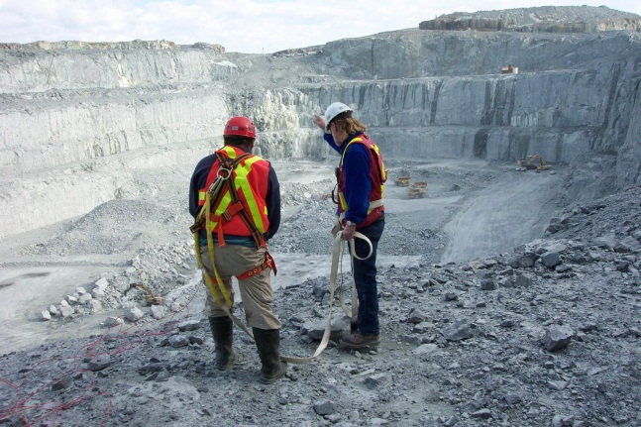


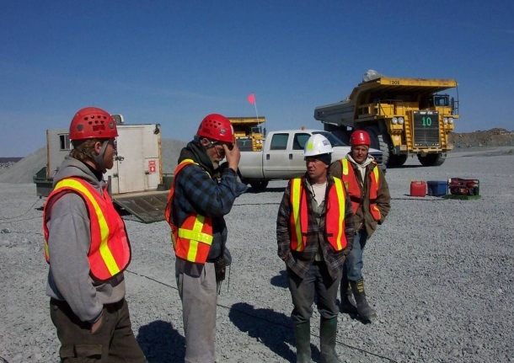
Committed to Safety
Safety
  HSE management system
  Full-time HSE specialist
  Member of ISNetworld & GGSSA
  Insured with Chartis
  Pre-field risk assessment
  Training (First Aid, WHMIS, TDG, driving, ATV, chainsaw, etc.)
Experience
  Our safe operations keep our most demanding clients happy. We operate safely for Junior Explorers and are approved operators for Major Mining companies like RTZ, BHP and AREVA.
Notes:
If you are working anywhere, safety is a huge concern and should be regarded equally high. At mine sites there are more people watching and concerned so the highest of standards must be adhered to

Slide 5
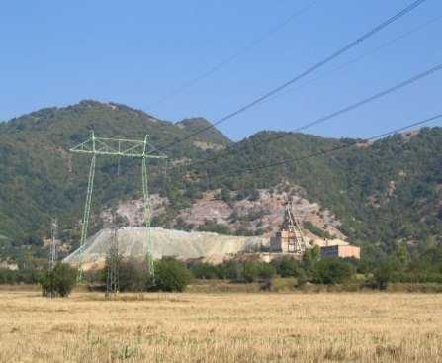
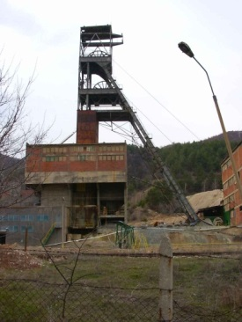
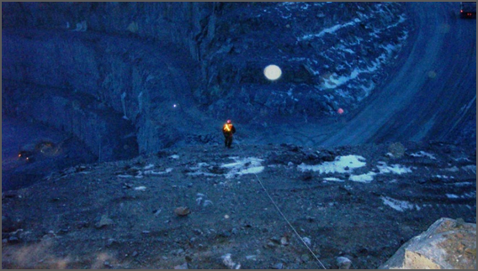
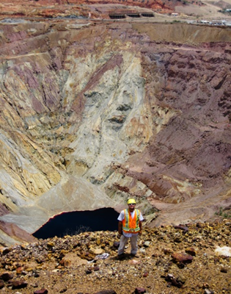
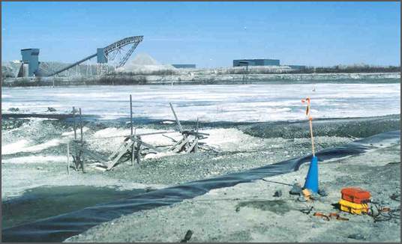
Mine site surveying has been challenging
Cultural noise
  Static metal
  Buildings
  Fences
Scheduling
  Haul roads
  Active Mine working
  Crew shifts
Electrical noise
  Power lines
  Transformers
  Shaft
Notes:
Cultural noise
Static metal
Buildings
Fences
Scheduling
Haul roads
Active Mine working
Crew shifts
Electrical noise
Power lines
Transformers
Shaft

Slide 6
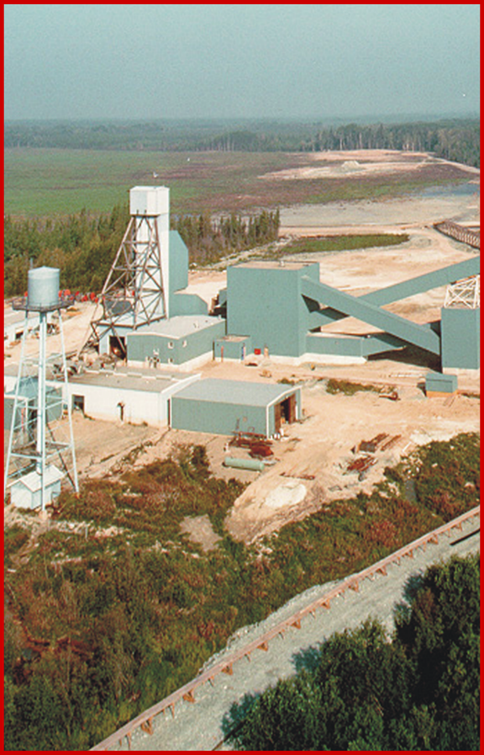
Mine site and near mine imaging
Exploration
  Rapid Imaging
  Little disruption
  Effective deep near mine search
Delineation
  Effective drill planning
  Orebody geometry
  Depth Extent
Mine Planning
  Condemnation, Tailings Plan
Notes:
Highly prospective
Economically important – Typically >40% of global exploration budgets
Opportunity to provide better return on drilling by surveying first with deep surveys

Slide 7
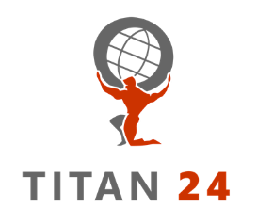
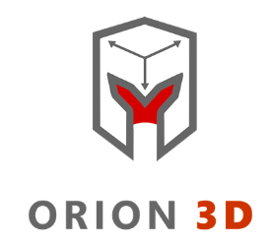
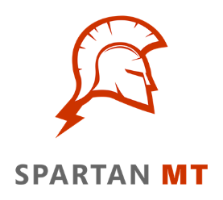
Technology typically for exploration
World Leading Deep Exploration Technology
2D Deep earth imaging – distributed data acquisition of multi-parameter geophysics: Resistivity, IP and broad band magnetotellurics (MT resistivity)
3D Imaging – complete 3D data acquisition for complex environments providing accurate surface to depth imaging of Resistivity, IP and MT
Flexible 2D and 3D deep resistivity imaging utilizing high resolution 24-bit MT
Broad Range of Expertise and Services
Survey design, planning, acquisition, QA/QC, interpretation, data integration and consulting services
Complete suite of conventional ground geophysical surveys including; gravity, magnetic, radiometric, IP (surface and borehole), TEM (surface and borehole), Max-Min, CSAMT and VLF
Notes:
Quantec has been built on carrying out anytype of geophysical survey anywhere.
Our old slogan used to be Anywhere, anyweather!
Since 2000 we have focused on providing sophisticated imaging services.

Slide 8
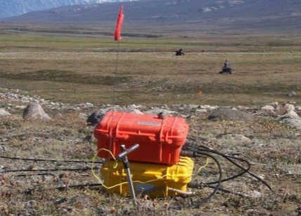
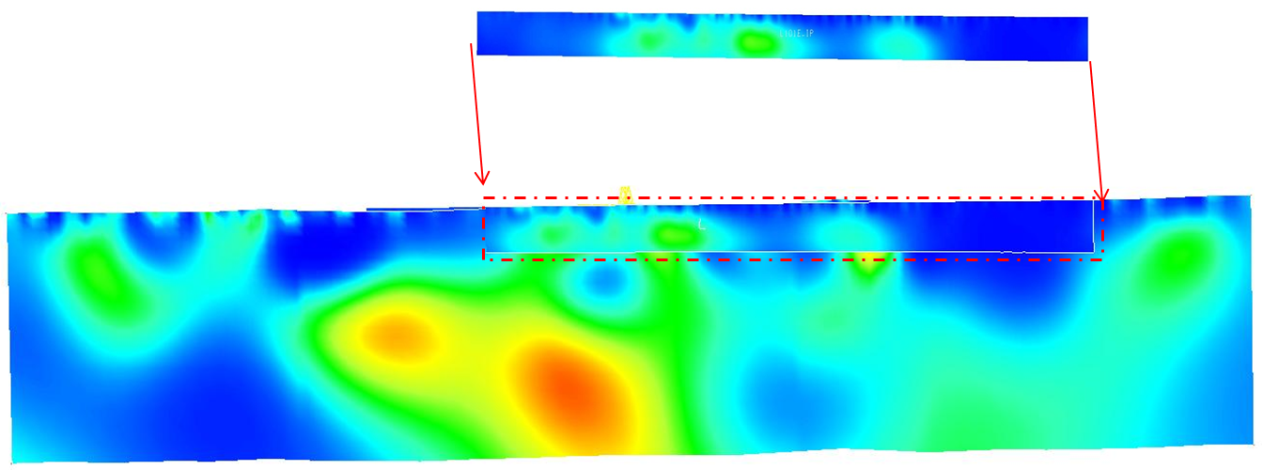
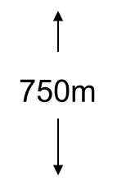
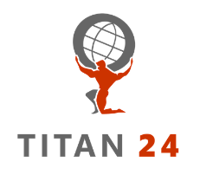
TITAN 24 system
Distributed multi-parameter data acquisition
Penetrates deeper than conventional geophysics
DC Resistivity, IP, MT
Depth of investigation to 700 - 1,500 m
Well-established in the industry
  15 Years
  Over 400 surveys
Effective for exploration in mine site environments
  60 surveys
Notes:
Titan is based on distributed computers/ receivers along long lines, to capture subtle responses from the earth and provide surface to depth information.
Note the example of traditional IP reaching roughly only 50 metres.

Slide 9
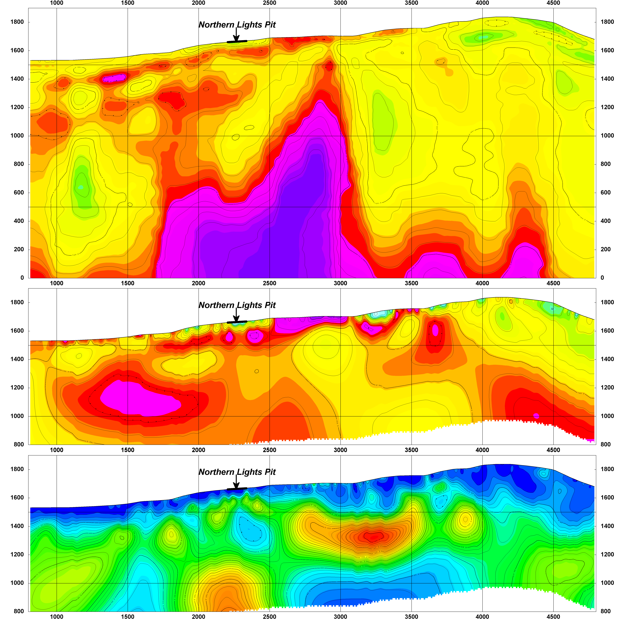
Deep multi-parameter information
Top panel: MT Resistivity
PW 2D inversion;
Middle panel: DC Resistivity
UBC smooth inversion;
Bottom panel: Chargeability
UBC smooth inversion.
Typically 1500 metres
Typically 500-750 metres
Notes:
Brief description
Newmont built their own NEWDAS system

Slide 10
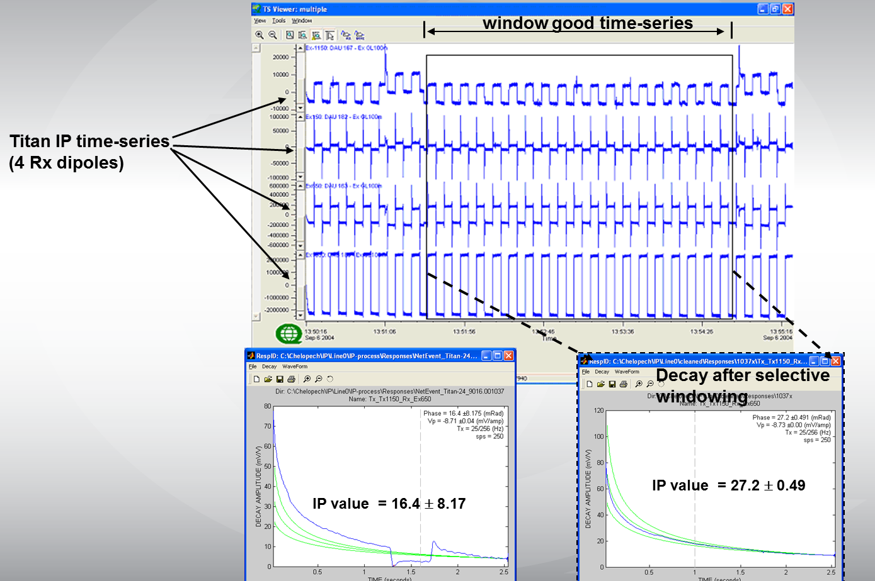
Minimize cultural noise by windowing
Notes:
Titan was built to measure small signals, to sample rapidly, to monitor current fluctuations,
This example shows….

Slide 11
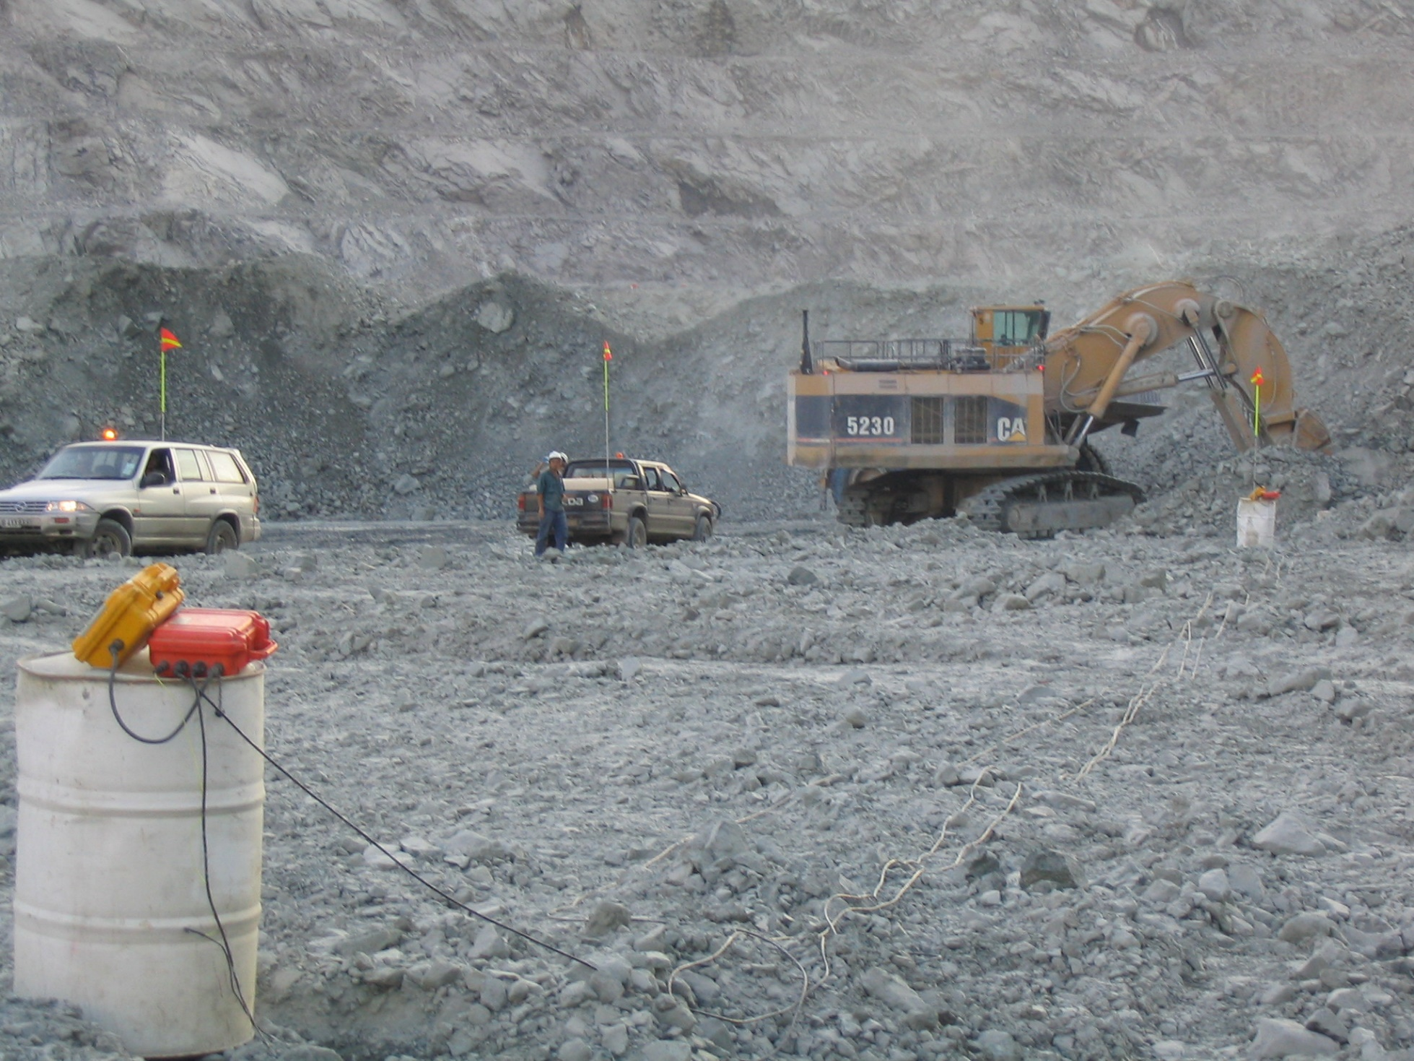
Station receivers measuring
simultaneously with 24 additional receivers
Notes:
An example of station set up in an active pit at a Diamond mine.

Slide 12
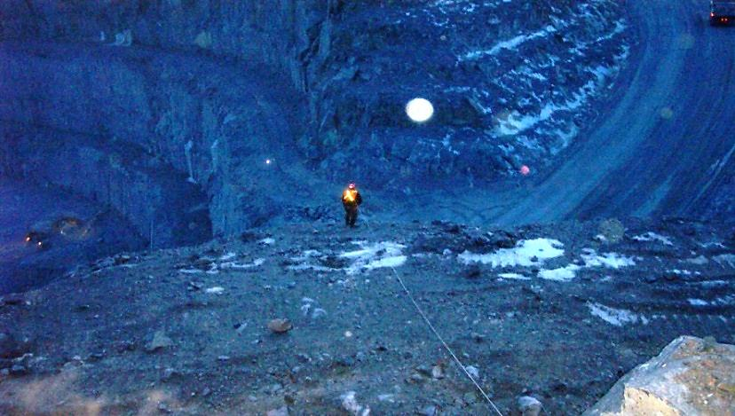
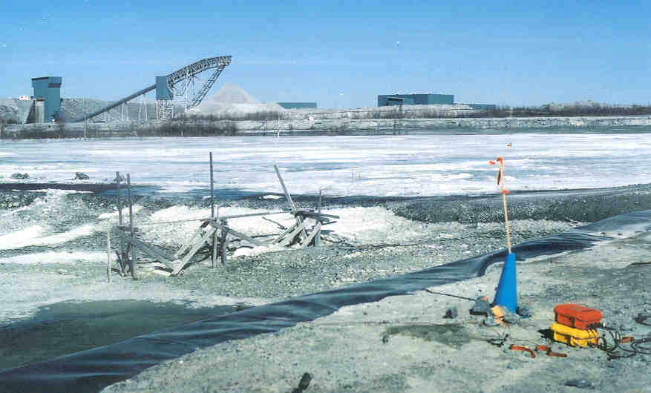
Over 60 mine site surveys
Some of our mine site clients…
Copper Mountain
Tenke Fungurume
Kidd Creek
Tati Nickel
Raglan
Ren
Red Lake Gold Mine
Geikle
Voisey’s Bay
Levack
San Nicolas
Black Fox Gold Mine
Fortitude
Chelopech
Borroo
Red Chris

Slide 13
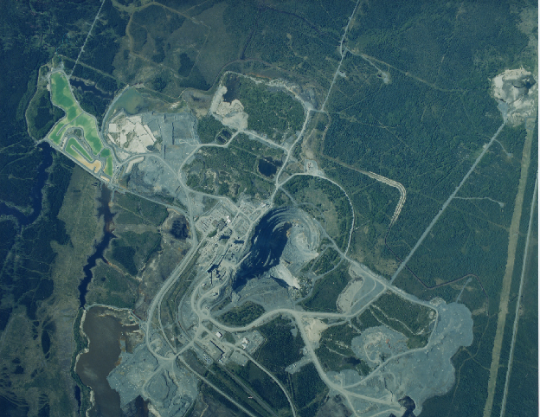
Kidd Creek
Titan 24 Survey Line Locations
800m
4800m
Titan 24
Lines
L11600N
200m
L11400N
500m
L11200N
Mine Buildings
and Workings
L11000N
L10800N
N
Kidd Creek
Open Pit
1
POWERLINE
0
km

Slide 14
Kidd Creek- Ontario
Unconstrained
Inversion
Surface
400m Below Surface
800m Below Surface

Slide 15
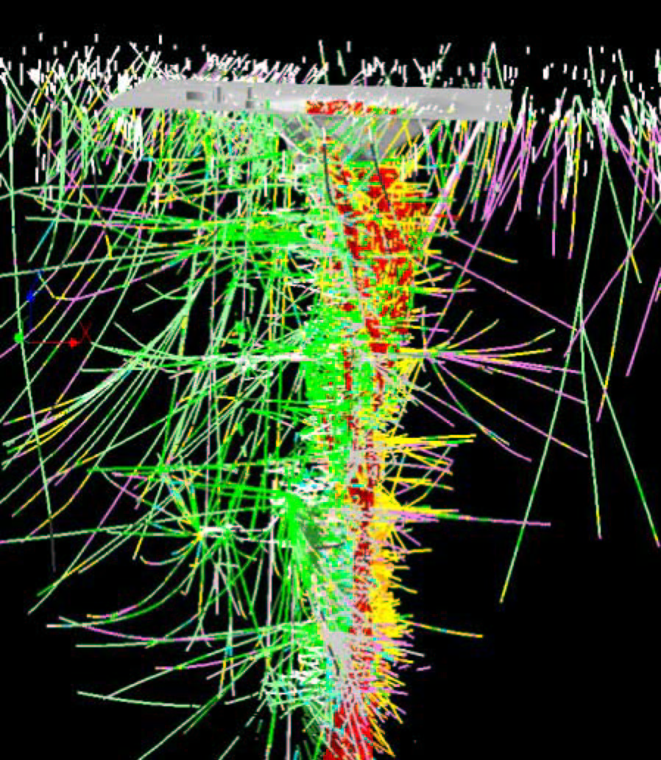
Kidd Creek- Ontario
Where to Drill?
Millions of dollars spent on drilling diamond drill holes ending in the barren rhyolite (circled area).
TITAN 24 survey indicated that the rhyolite was barren

Slide 16
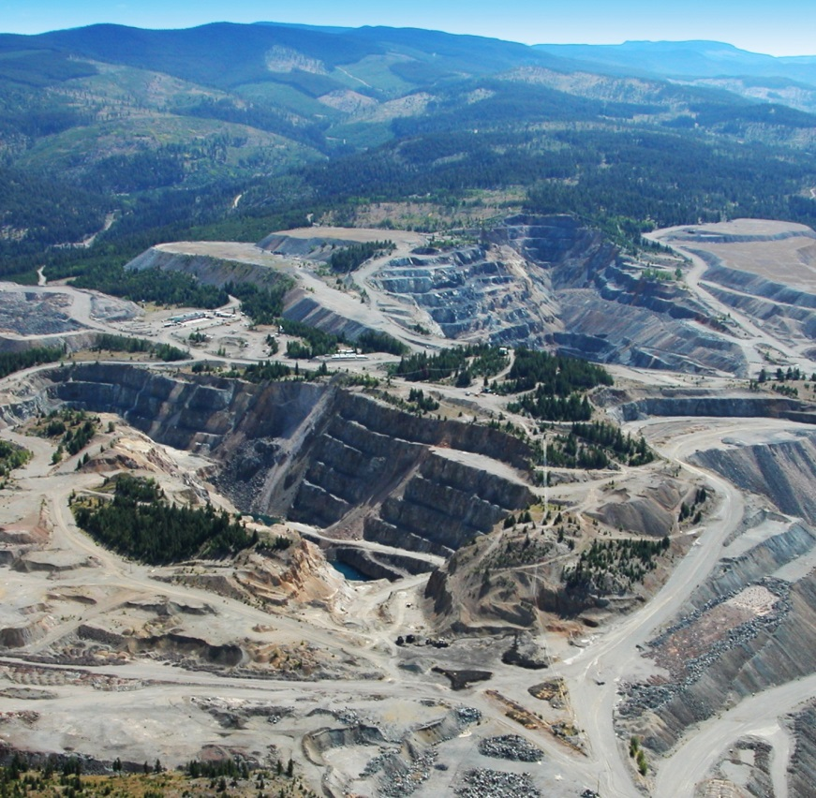
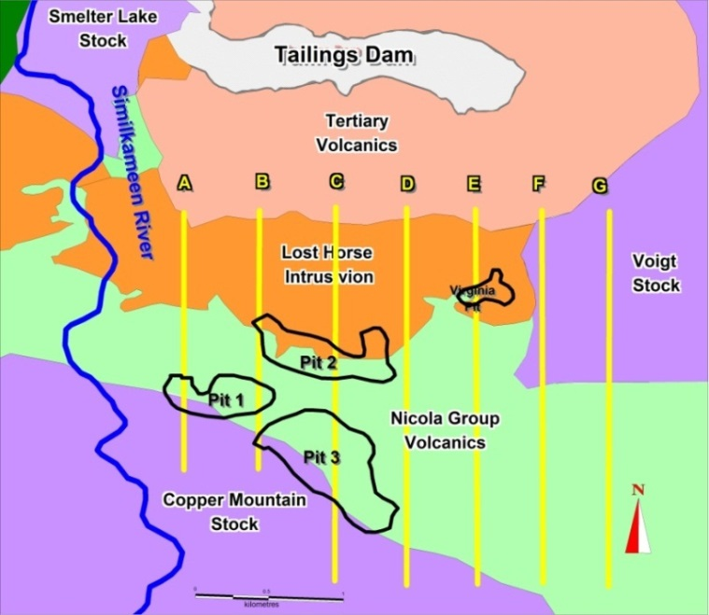
Copper Mountain BC - Exploration Objectives
To confirm continuity of mineralization between the pits.
To test and possibly expand reported resources between existing pits in order to identify a new merged pit- known as the “Super Pit.”
To identify the potential for large, deep-seated porphyry deposits through a comprehensive mine site exploration program.
Images of Active Pits and Geology with Titan 24 Line Locations

Slide 17
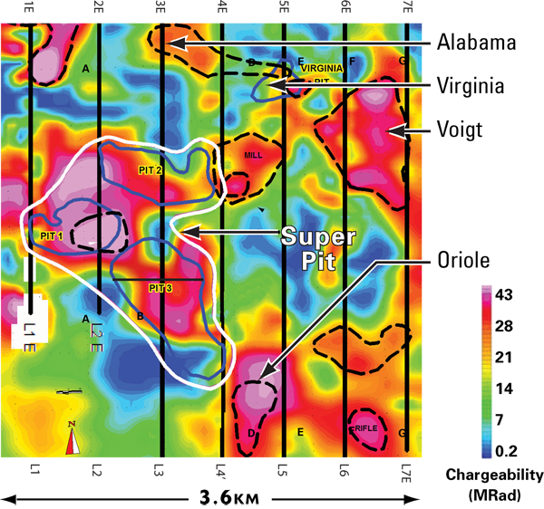
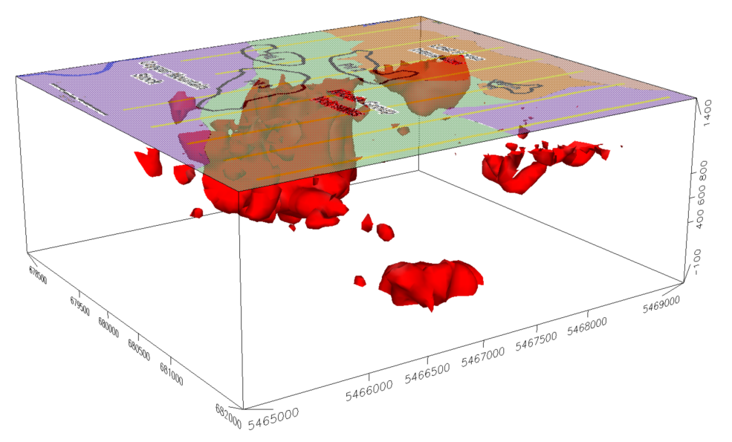
IP Plan (200 m) and 3D Map
Copper Mountain – 3D View
IP anomalies centred over current pits
3D image shows continuity of chargeability and potential depth extent
40 mrad chargeability surface

Slide 18
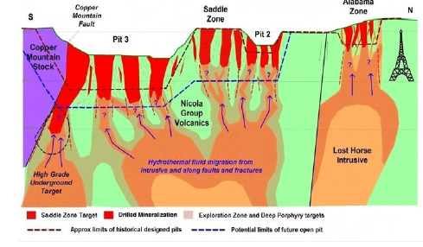
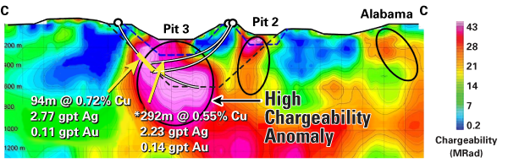
Geology model and resultant IP

Slide 19
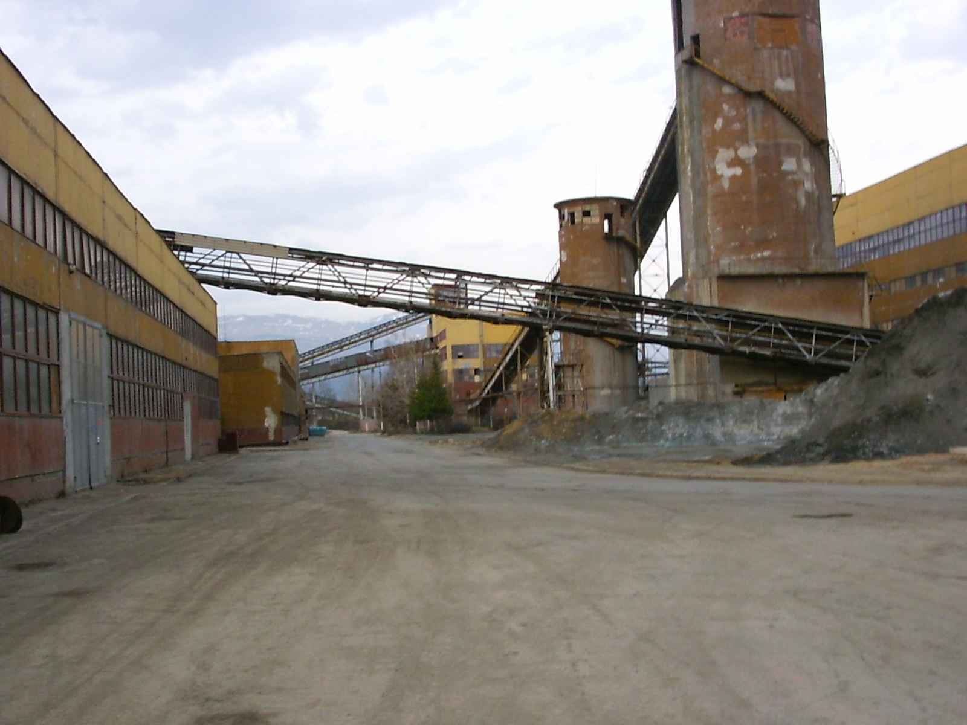
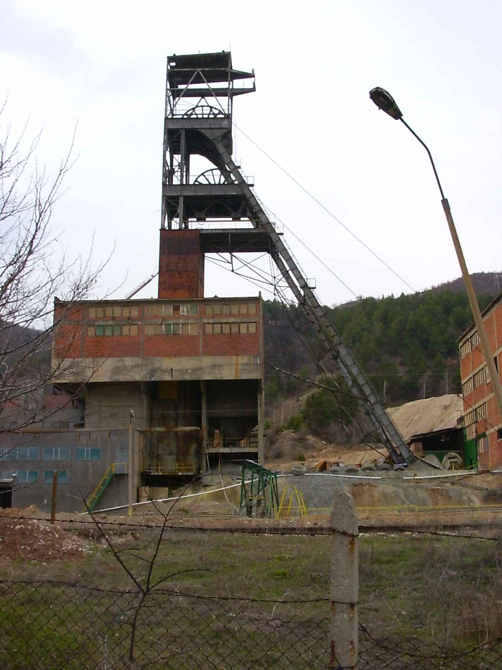
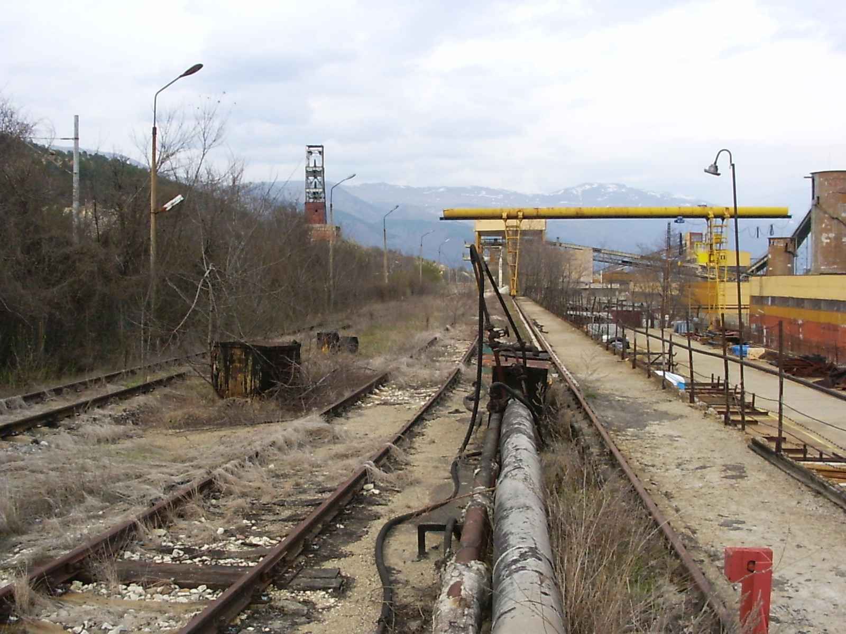
Chelopech, Bulgaria
Case Study

Slide 20

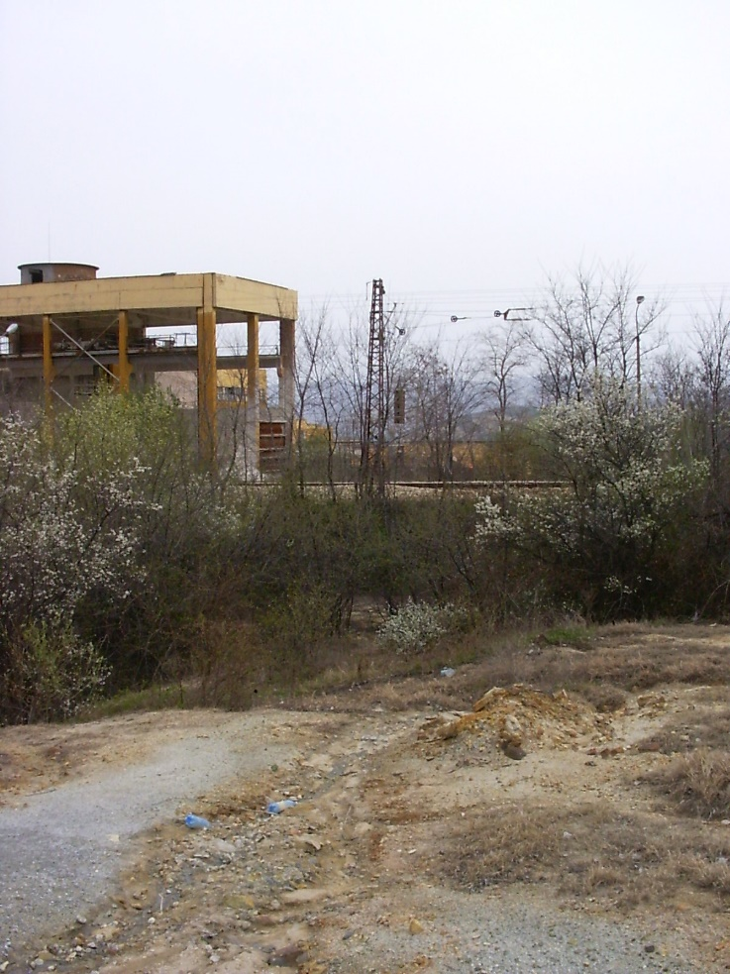
Digital Signal Processing
Simultaneity
Remote Referenced Data

Slide 21
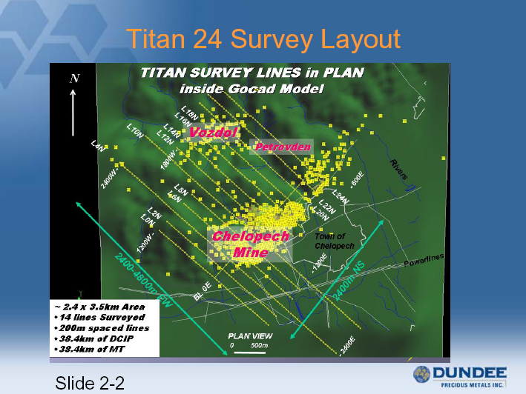

Slide 22
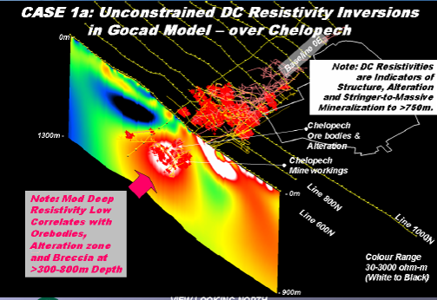
Resistivity model matches deposit
Notes:
Ore body characterization study

Slide 23
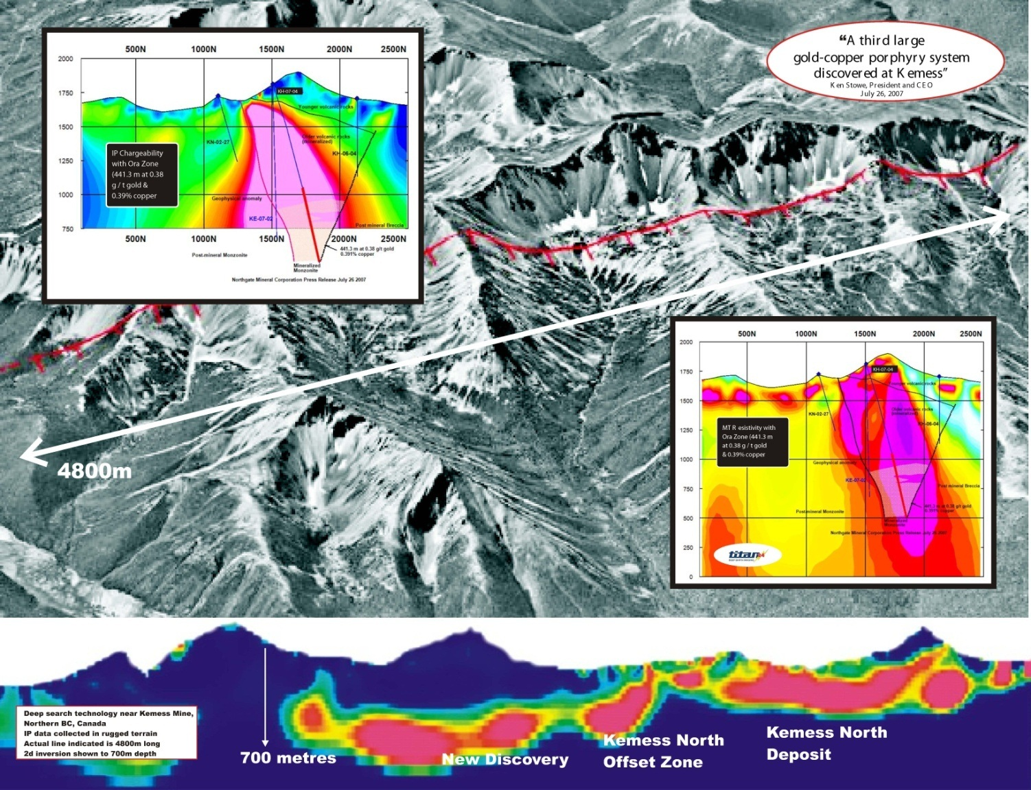
Kemess North – Orebody Extension

Slide 24
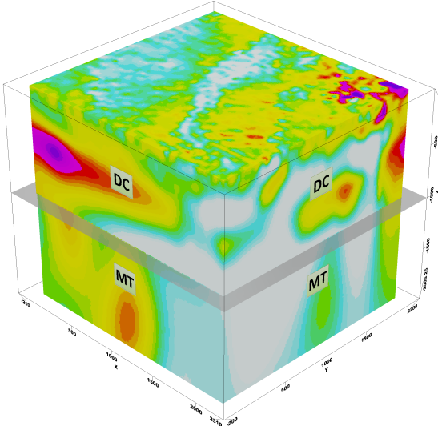
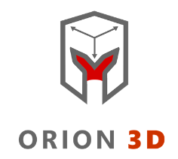
ORION 3D surveys
Accurate imaging for complex environments
  Depth of investigation to 1,500 m for Resistivity, 750m for IP
  Confidence in interpretation
True 3D acquisition
  Omni-directional super-sampling
Multi-parameter
  DC Resistivity, IP, MT

Slide 25
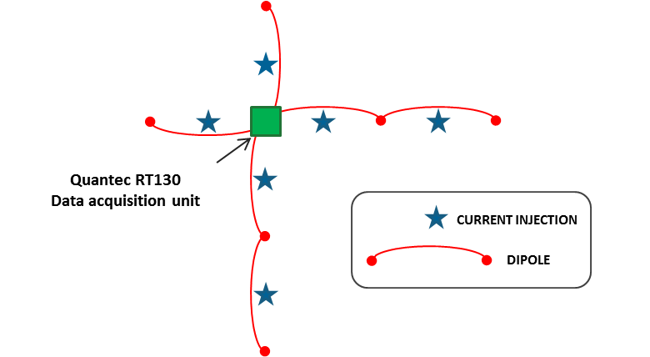
Designed for complex environments
Built on the strengths of:
  TITAN 24 Technology & Processing (over 15 years of technical Success and Discovery)
  SPARTAN MT Flexibility

Slide 26
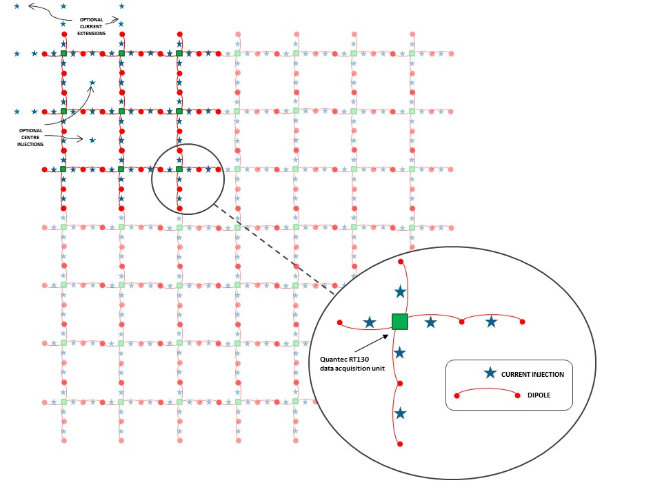
REAL 3D data acquisition
2 x 2 km area
  Scaleable
Up to 300 receiver channels for every transmit
Unprecedented: equal number of orthogonal dipoles

Slide 27
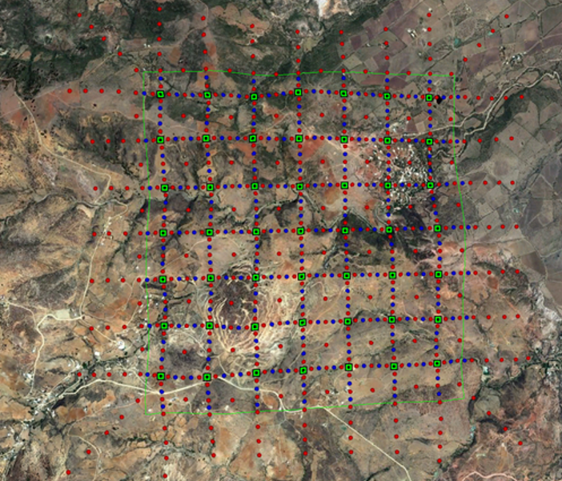

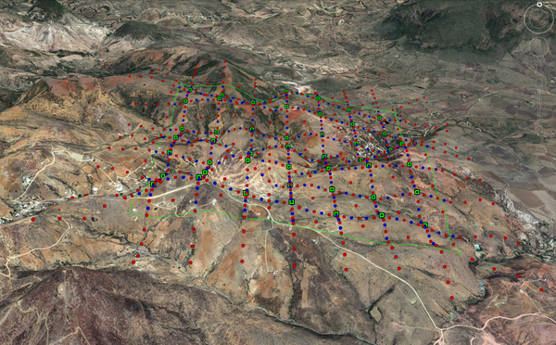
Survey footprint

Slide 28
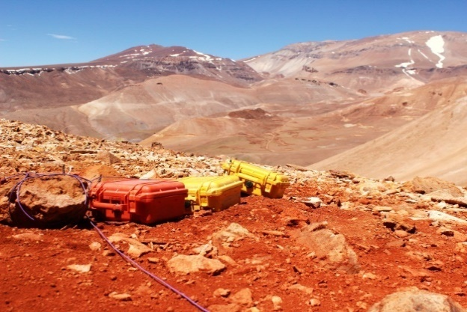
ORION 3D layout
Receiver dipole
Data recorder
Current injection
“Conceptual”
current path
True 3D DCIP measurement
Simultaneous receiver sampling
Omnidirectional data free from receiver geometry bias

Slide 29
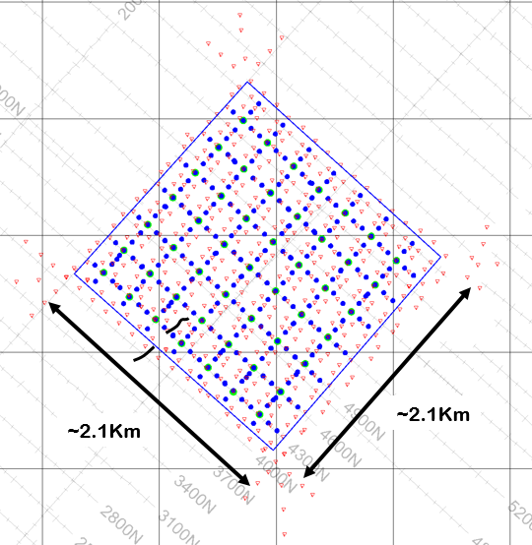
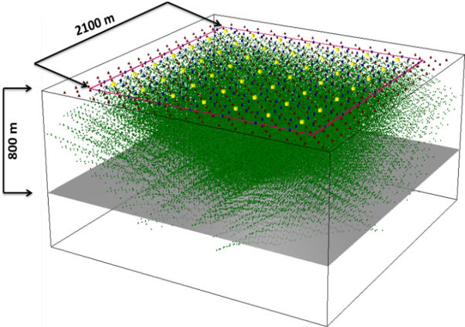
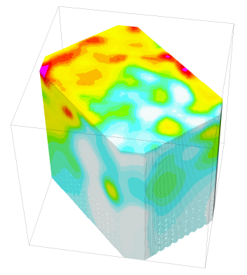
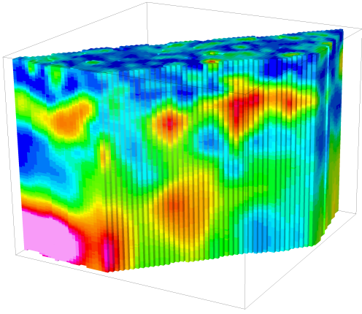
The ORION 3D advantage
Survey flexibility
  Distributed acquisition allows for customization of the survey layout
3D geometry
  The survey samples local geology from all directions simultaneously
High signal-to-noise ratio
  Low-noise electronics ensure high quality data
Depth penetration
  Large-offset data acquisition ensures maximum depth penetration
High resolution
  High data volume boosts the resolution of the survey and supports confident and accurate interpretations
Yields best representation of the subsurface for drill planning
Layout Planned Coverage Results Targets

Slide 30
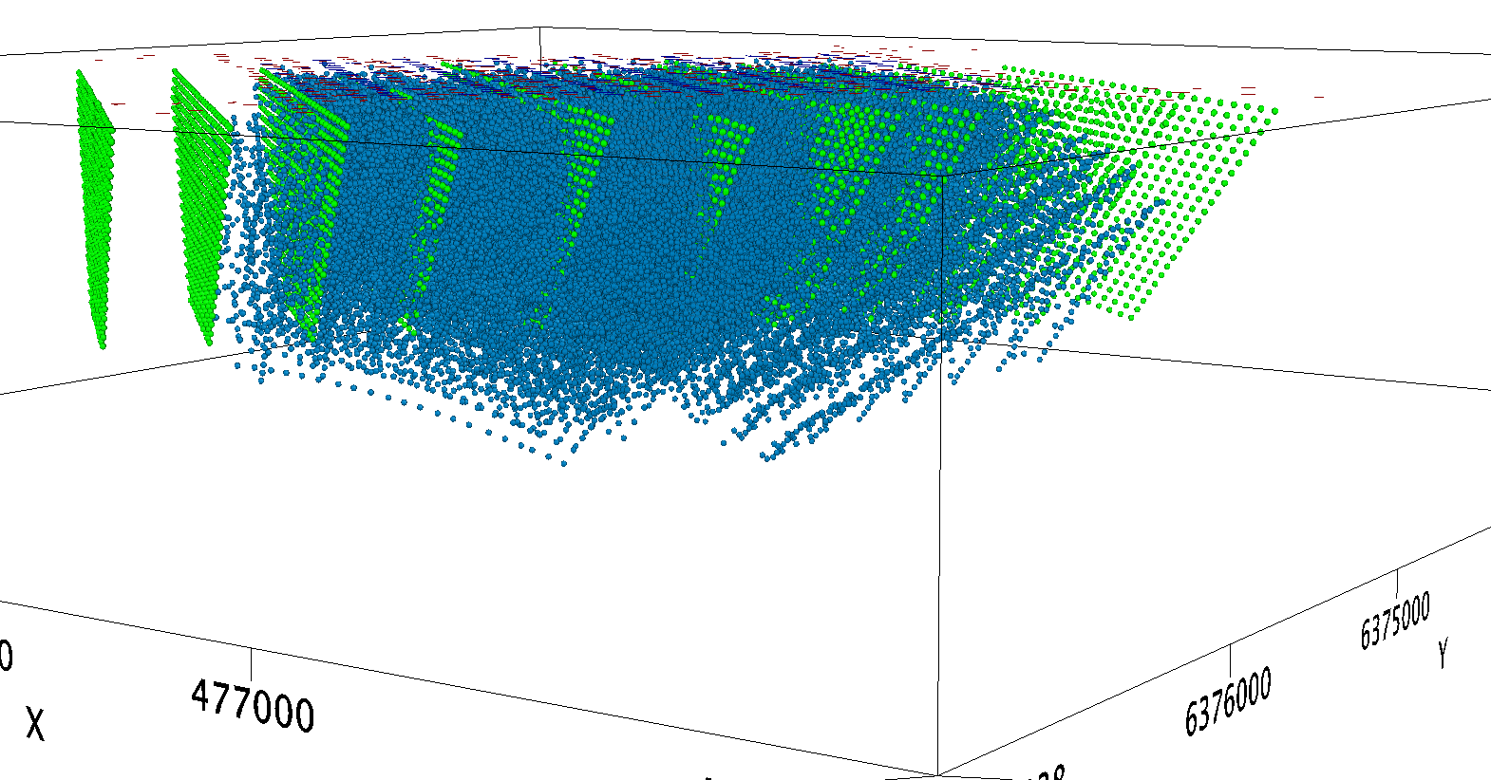


Sampling everything (from all directions)
2D Data
3D Data
More than 140,000 samples
Omni-directional sampling for unparalleled definition in complex environments
Notes:
The TITAN lines are shown as 2d pseudo-sections represented the apparent data in a typical way.
The TITAN lines are plotted in green to great depth because TITAN can achieve this, conventional cannot.
A couple of ORION transmits are shown in blue – at the corner and in the center with the apparent plot points associated.
When all the ORION transmits are added, the apparent plot points fill the survey area.

Slide 31


Technology impact on planning and risk?
Thorough, accurate imaging for improved drill planning
  Detection of deeper, more subtle geophysical responses
  Imaging through deep overburden conditions
  Surveying in high noise environments (active mining operations)
  Decreases the chance that the “big one” will be missed
  Decreases overall exploration cost by providing better targeting information
Applications:
  VMS, porphyry, gold, silver, copper
  Nickel, PGE’s, IOCG, uranium, diamonds

Slide 32

Kitumba, Africa ORION 3D IP Model
750m x 1 km x 750m

Slide 33



ORION 3D delineation results
Image “Before” drilling
Improve planning
to save money
Mineralisation inside geophysical target

Slide 34




BIG DATA is an asset for the project
Looking North
(Az 360º Inc 25º)
WS conductor
with Phoenix
drilling
UC Model

Slide 35





Mine site imaging surveys
Copper Mtn
  Mine planning
    Condemnation
    Tailings
Kemess
  Discovery
Kitumba
  Resource Targeting
    Drill plans
    Data asset
Improve drill targeting
Mineralization inside geophysical target
Notes:
TITAN 24 and ORION 3D are technologies that can effectively discover new ore zones and delineate extensions of existing ore zones in a variety of environments
A TITAN 24 and ORION 3D surveys can be conducted directly over and around the mine site
TiITAN 24 and ORION 3D imaging first provides improved return on near mine exploration drilling by condemning ground faster, and providing enhanced REAL3D Targets

Slide 36
Thank YOU!
www.quantecgeoscience.com

